Slide 1

AI-Powered Customer Support Email Generator (Flask API)
Automating Professional Email Responses
Presented By -
Mahale Jayesh Sanjay – 25030242034
Kotha Rupa Reddy – 25030242033
Mahima Arora – 25030242035

Slide 2

Introduction
Problem:
Solution:
Manual handling of customer complaints takes time and lacks consistency
AI-powered automated email generator
Built with Flask API + Google Gemini AI

Slide 3
Objectives
Professional Responses
Consistent Tone
Generate professional email responses
Ensure tone is empathetic, polite, and helpful
Reusable API
Easy Integration
Provide structured and reusable Flask API
Enable integration with front-end apps or dashboards

Slide 4





Tech Stack Overview
Programming Language
Framework
AI Model
Python
Flask (API + routing)
Google Gemini (Generative AI)
Configuration
Other Tools
YAML-based (config.yaml)
Logging, Flask-CORS

Slide 5
Libraries Used
01
02
03
os
yaml
logging
File/directory handling
Load configuration (API keys, model, logging)
Error & activity tracking
04
05
06
datetime
flask
flask_cors
Timestamp generation
Web framework for API
Handle CORS requests
07
google.generativeai
Gemini AI model integration

Slide 6





Project Architecture
Frontend
Backend
index.html (User interface)
Flask API (Endpoints for generation)
AI Engine
Storage/Logs
Google Gemini API
Local logging for monitoring
Infrastructure
Integration
Reliable cloud and on-prem resources
APIs, messaging and data pipelines
Security
Observability
Identity, encryption and governance
Monitoring, logs and performance insights

Slide 7
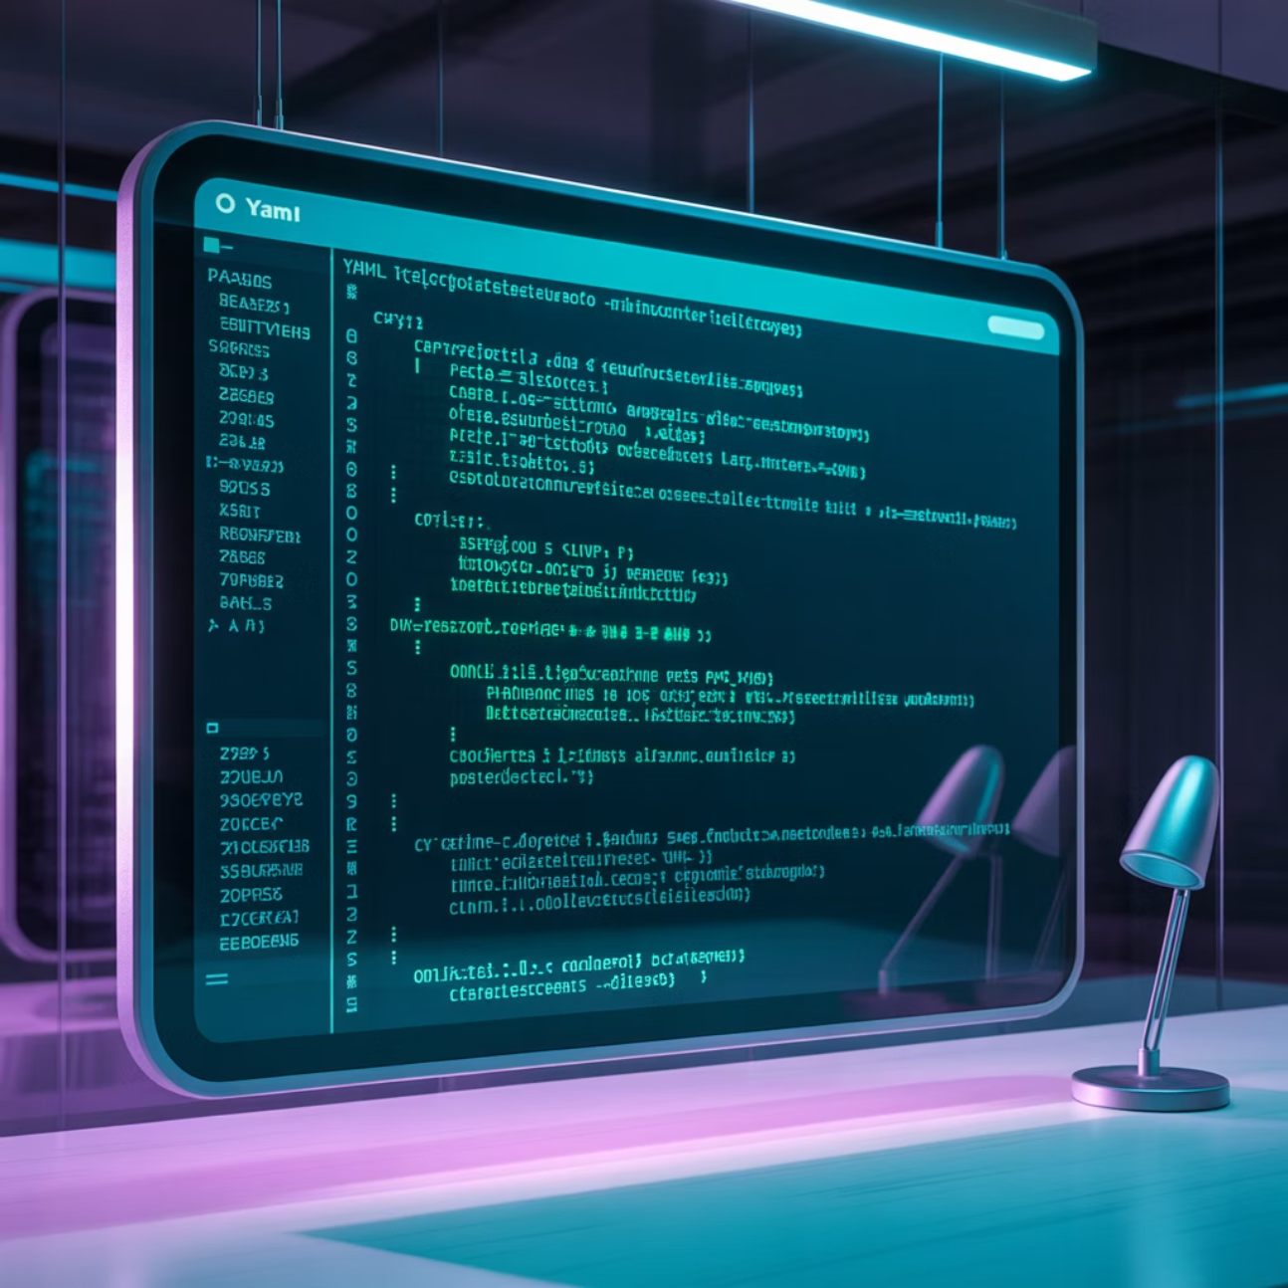
Configuration Handling
config.yaml contains:
Gemini API key
Model name
Logging levels
API host/port settings
load_config() function loads configuration dynamically

Slide 8
Logging System
Configurable Levels
Request Tracking
Error Details
Configurable log level (INFO, DEBUG, ERROR)
Logs API requests & AI responses
Stores error details for debugging
Example:
2025-09-21 02:15 - root - INFO - Successfully generated email...

Slide 9
API Endpoints
1
/
2
/generate_email (POST)
Renders main page (index.html)
Generates AI-powered email
Input: JSON with "complaint" field
Output: JSON with generated email & timestamp

Slide 10

Email Generation Logic
Steps inside /generate_email:
Validate Input
Validate input complaint
Prepare Prompt
Prepare AI prompt (structured instructions)
Call AI API
Call Gemini AI API with parameters (temperature, tokens, top_p, top_k)
Parse Response
Parse response → Extract generated email
Return JSON
Return structured JSON response

Slide 11
Prompt Engineering
AI Prompt Includes:
Acknowledgement
Empathy
Solution
Acknowledging customer's concern
Empathy & understanding
Providing a helpful solution
Professional Tone
Structure
Professional tone (concise + polite)
Greeting & closing

Slide 12
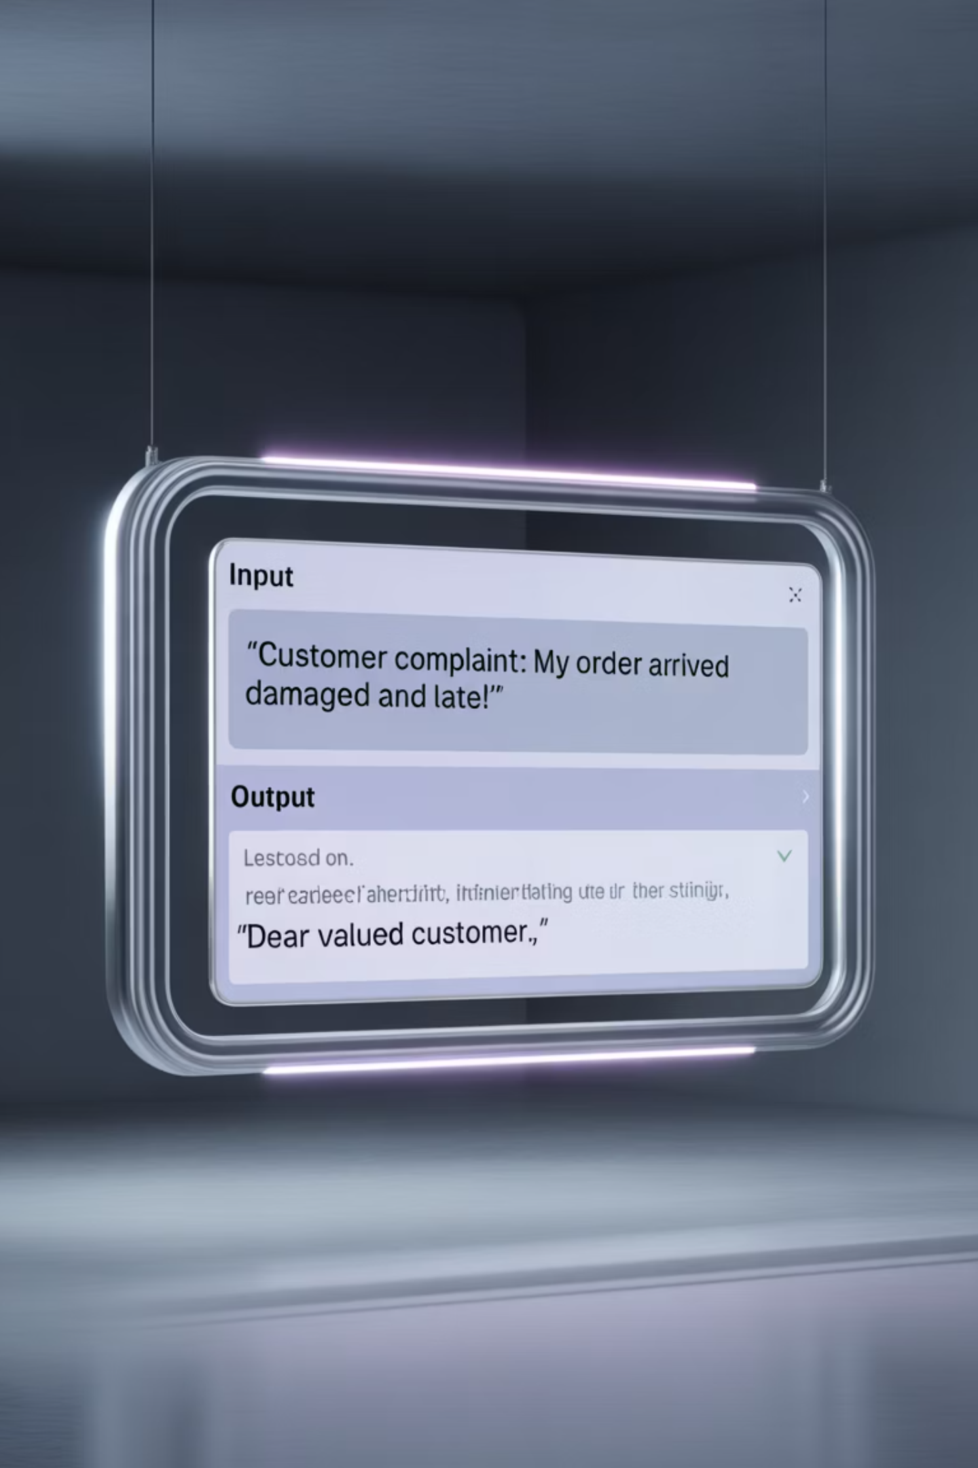
Example Input/Output
Input JSON:
Output JSON:
{ "complaint": "I received a damaged product and want a replacement." }
{ "success": true, "email": "Dear Customer, we sincerely apologize...", "timestamp": "2025-09-21T02:30:45" }

Slide 13








Error Handling
Input Validation
Empty Input
Handles missing complaint text
Empty input validation
API Configuration
Exception Handling
Missing Gemini model/API key
Exception handling → Returns structured error JSON

Slide 14

Deployment & Usage
Run locally with Flask:
python app.py
Server runs at http://127.0.0.1:5000
Can be deployed on:
Heroku
Google Cloud Run
AWS Elastic Beanstalk

Slide 15
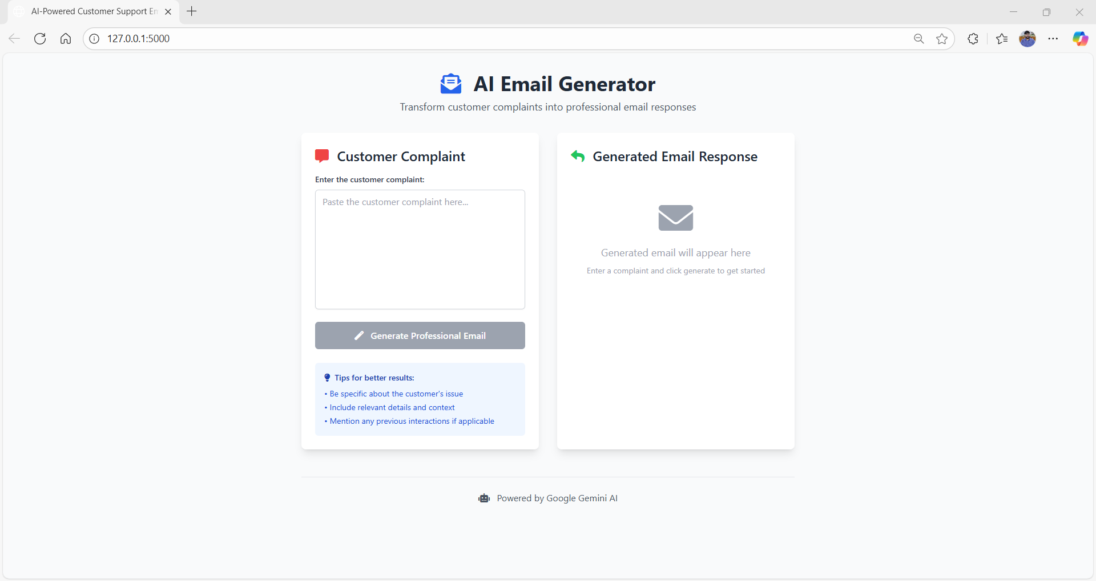

Slide 16
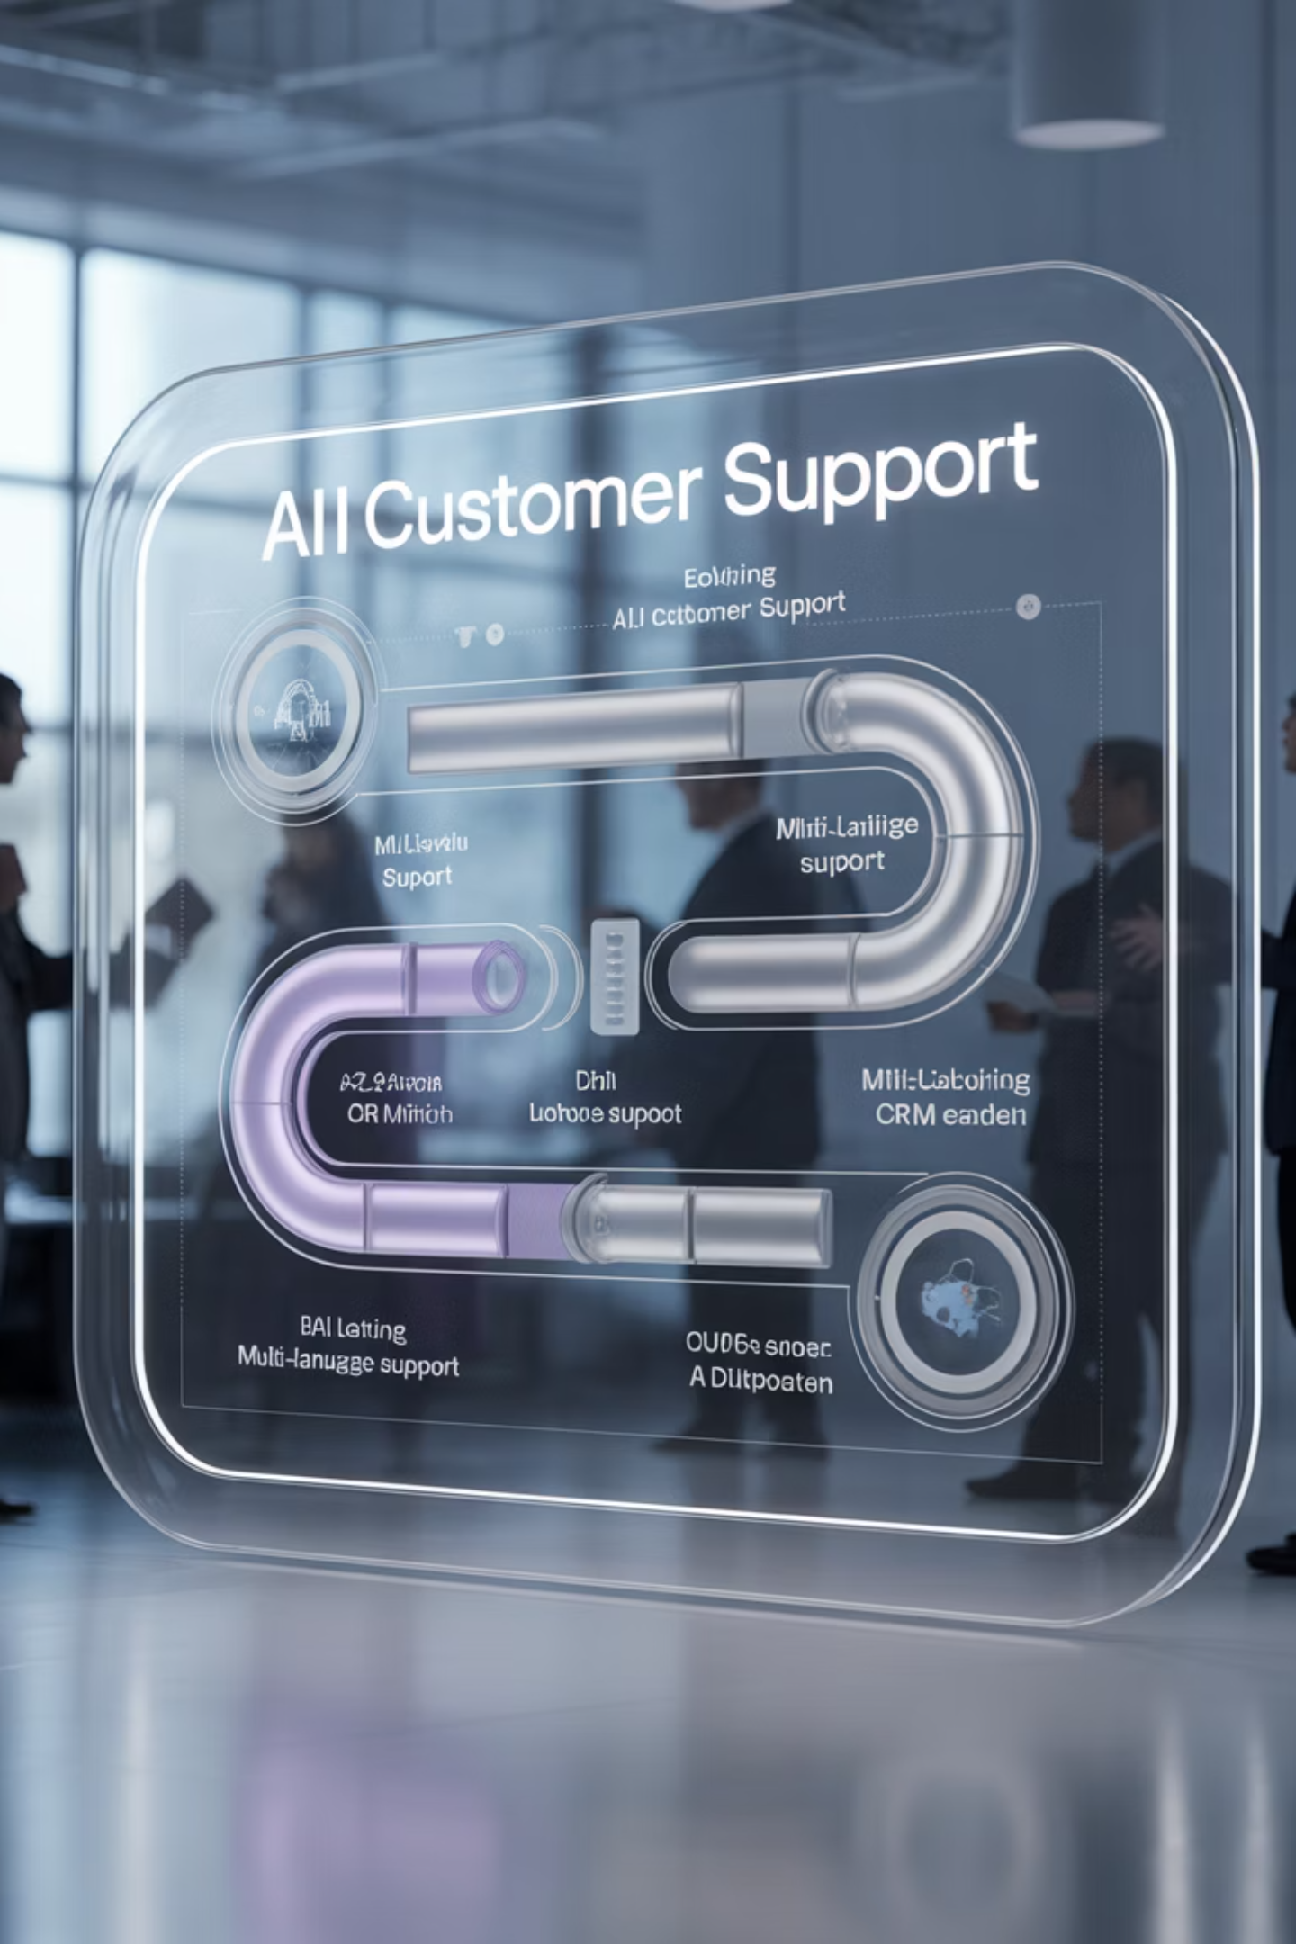
Conclusion & Future Scope
Conclusion:
Future Enhancements:
Automates customer support emails
Multi-language support
Sentiment analysis before response
Saves time & improves consistency
Integration with CRM systems

